Slide 1
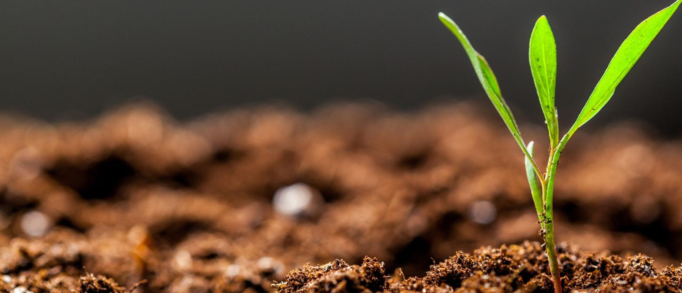

AI WITH PYTHON
ASSIGNMENT-1

Slide 2

KTC-HUBLI
ASSIGNMENT-1
TEAM MEMBERS
Priyanka
Samarth
Abhishek
Joel
Vinayak

Slide 3
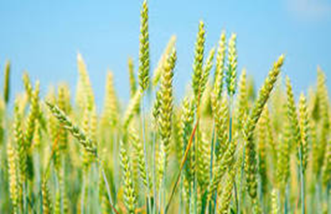
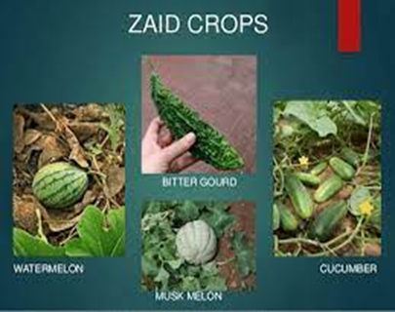
Create a high level concept amount and type of fertilizers and pesticides required for the type of agriculture products to be harvested based on the soil and monsoon prediction.
Agriculture is the art and science of cultivating the soil , growing crops and raising livestock. It includes the preparation of plant and animal products for people to use and their distribution to markets. Agriculture provides most of the world’s food and fabrics.
Agriculture has been the backbone of the Indian economy and it will continue to remain so for a long time. India is a global agricultural powerhouse. It is the world’s largest producer of milk , pulses and spices and has the world’s largest cattle.
there are three distinct crop seasons in India , they are
Kharif
Rabi
Zaid

Slide 4
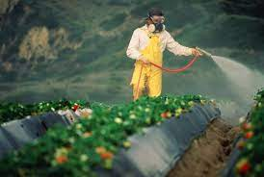
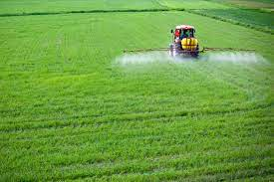
PESTICIDES AND FERTILIZERS
Both fertilizers and pesticides have a strong bonding with each other. In order to get rid of crops and soil going damage due to heavy rain, flood and drought kind of situation, pesticides and fertilizers are used. They stimulate crop’s growth with greater yield, help in irrigation, crop protection, control pests, kill weeds, prevent diseases and protect food and much more.

Slide 5
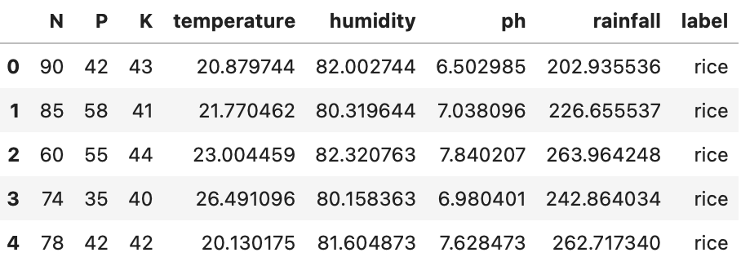
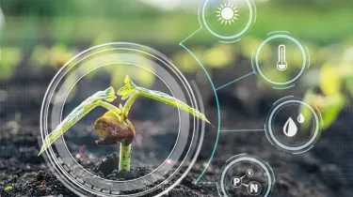
CROP RECOMMENDATION
Crop Recommendation system using Machine Learning that predicts crop suitability by factoring all relevant data such as temperature, rainfall, location, and soil condition. This system is primarily concerned with performing agro Consultant's principal role, which is to provide crop recommendations to farmers.
FEATURES OF CROP RECOMMENDATION
Soil PH
Humidity
NPK levels
Crop data
Temperature

Slide 6
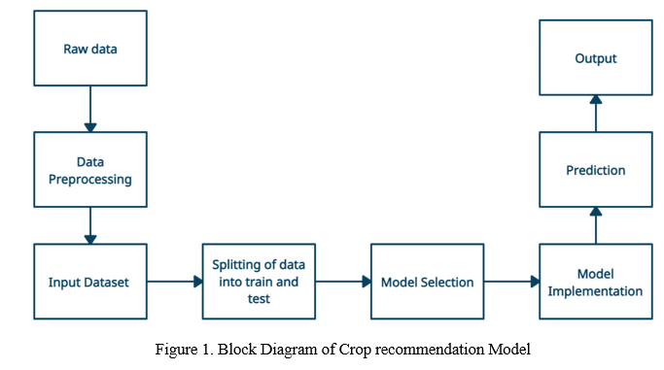
CROP RECOMMENDATION MODEL

Slide 7
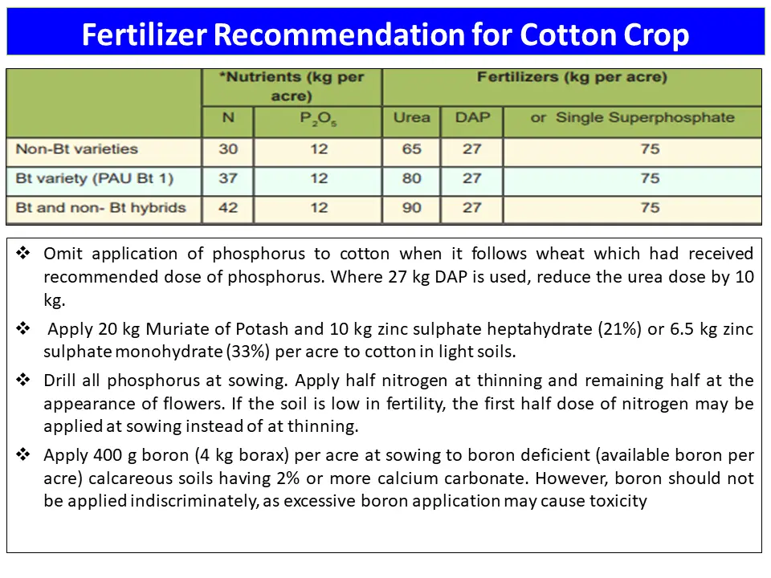
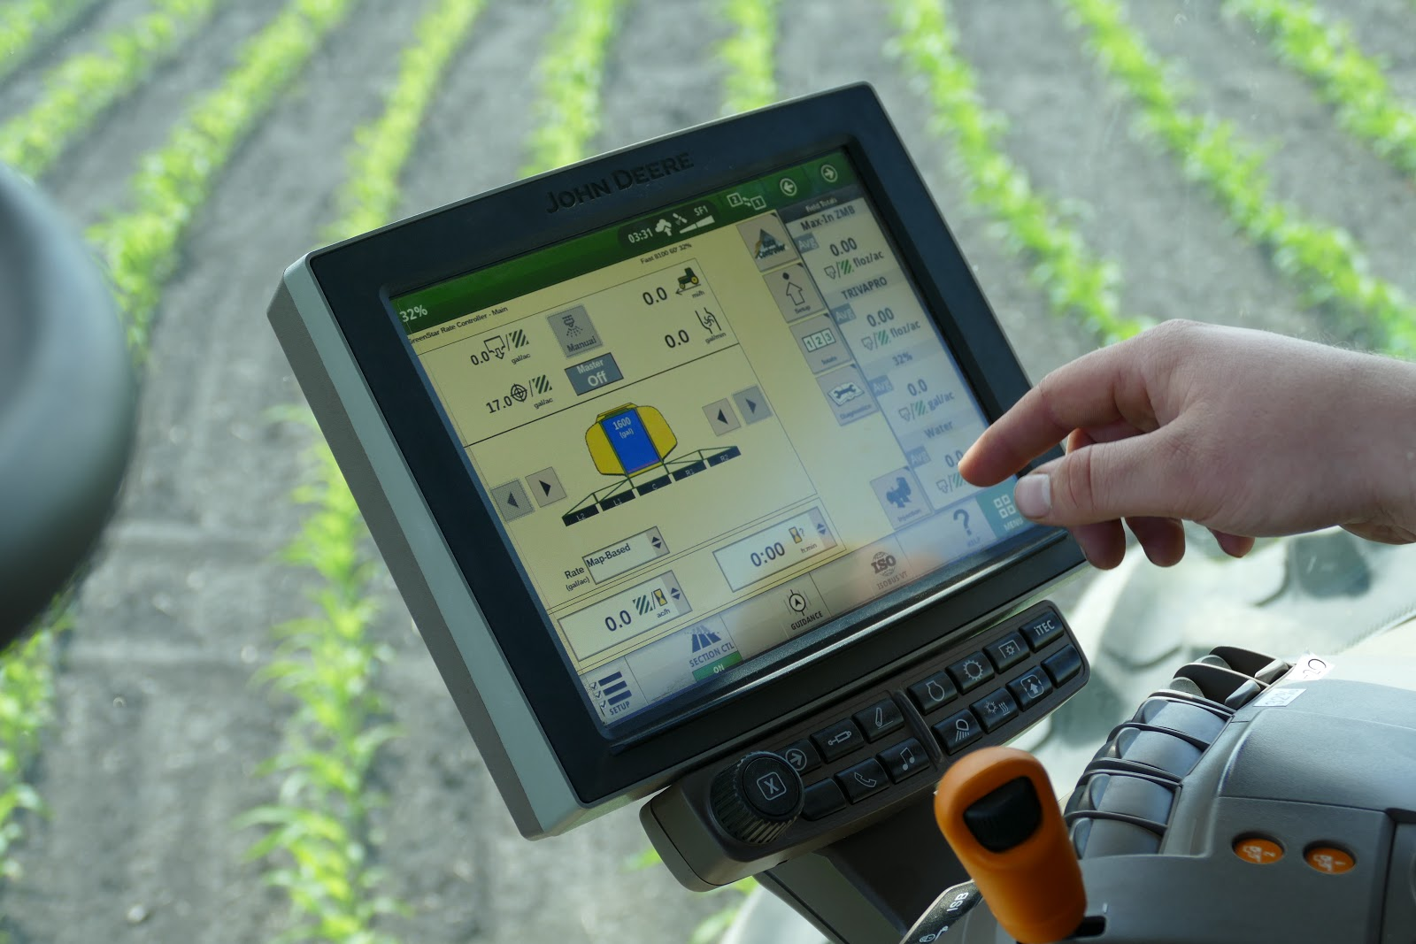
CEOP RECOMMENDATION

Slide 8
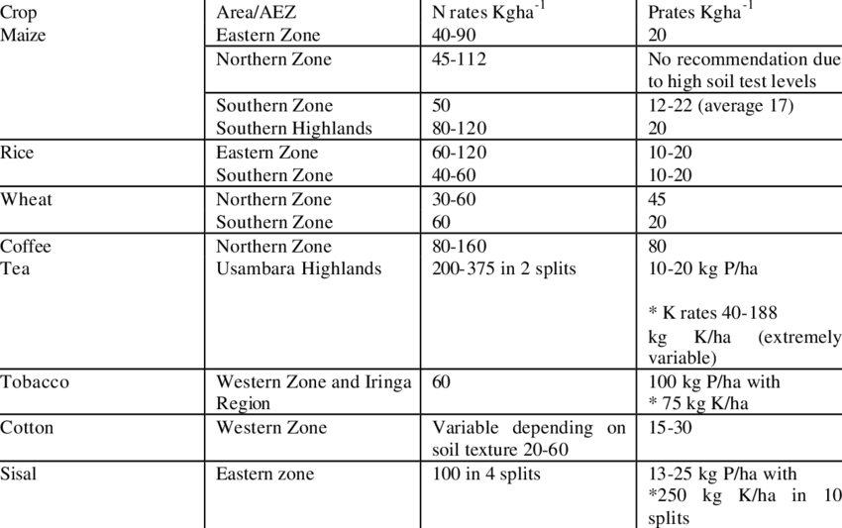
CROP RECOMMENDATION Selected recommendation for the main crops

Slide 9
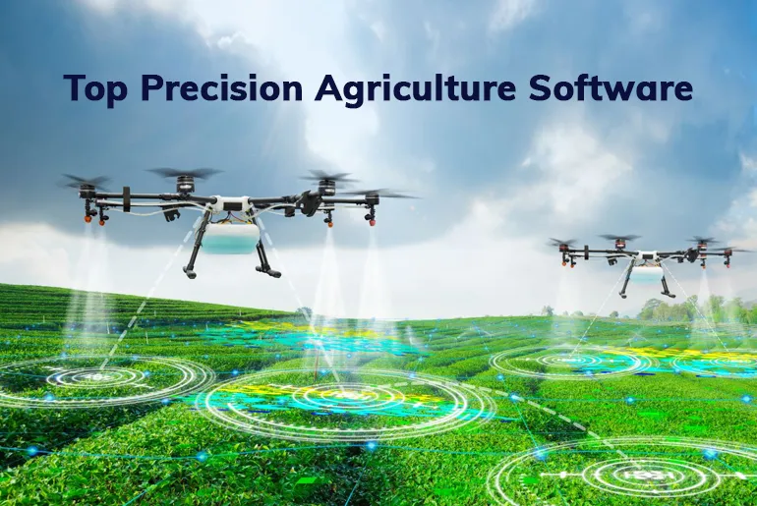
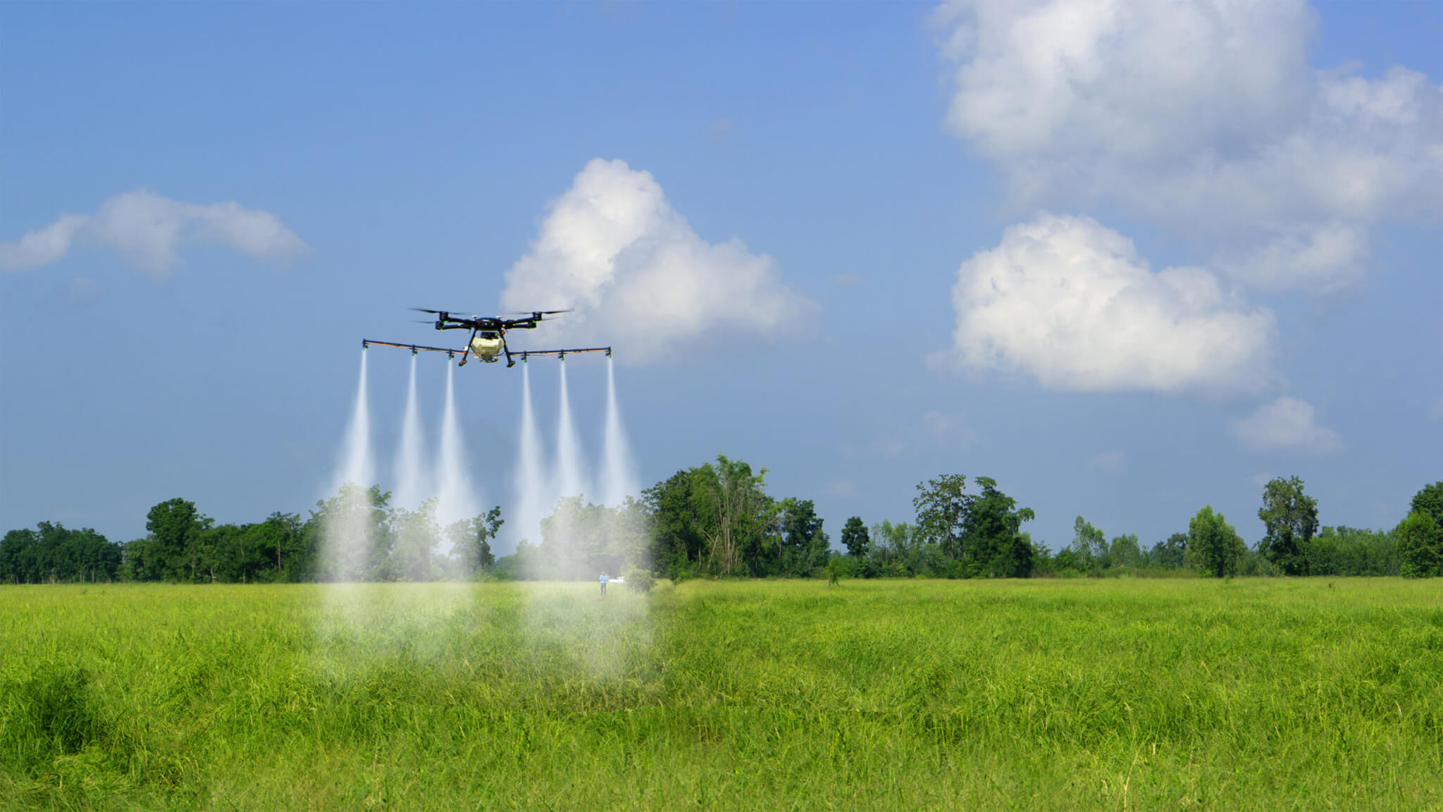
PRECISION AGRICULTURE
Precision agriculture (PA) is the science of improving crop yields and assisting management decisions using high technology sensor and analysis tools. PA is a new concept adopted throughout the world to increase production, reduce labor time, and ensure the effective management of fertilizers and irrigation processes.
TYPES OF PRECISION AGRICULTURE
Soil sampling and analysis
Weather monitoring
Labour management
Equipment management

Slide 10
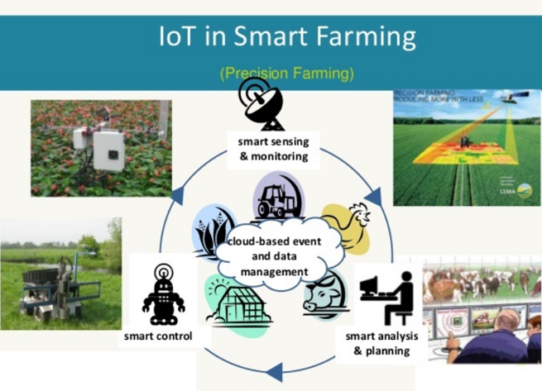
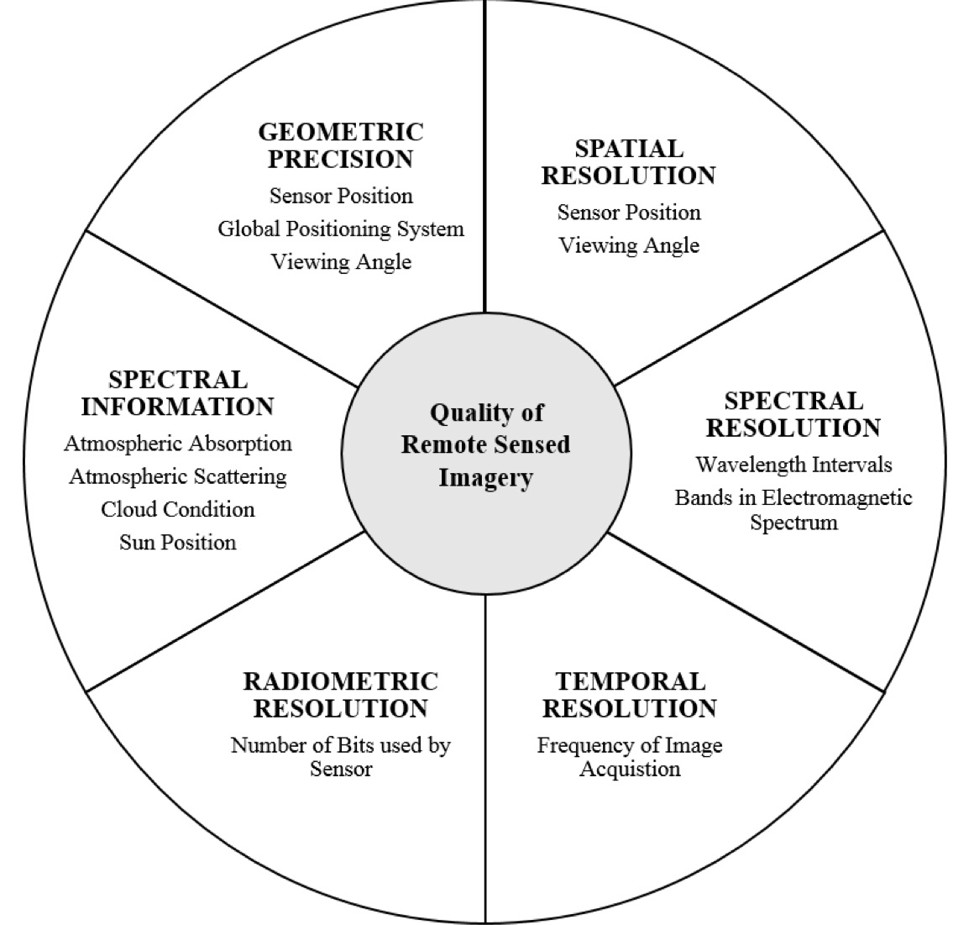
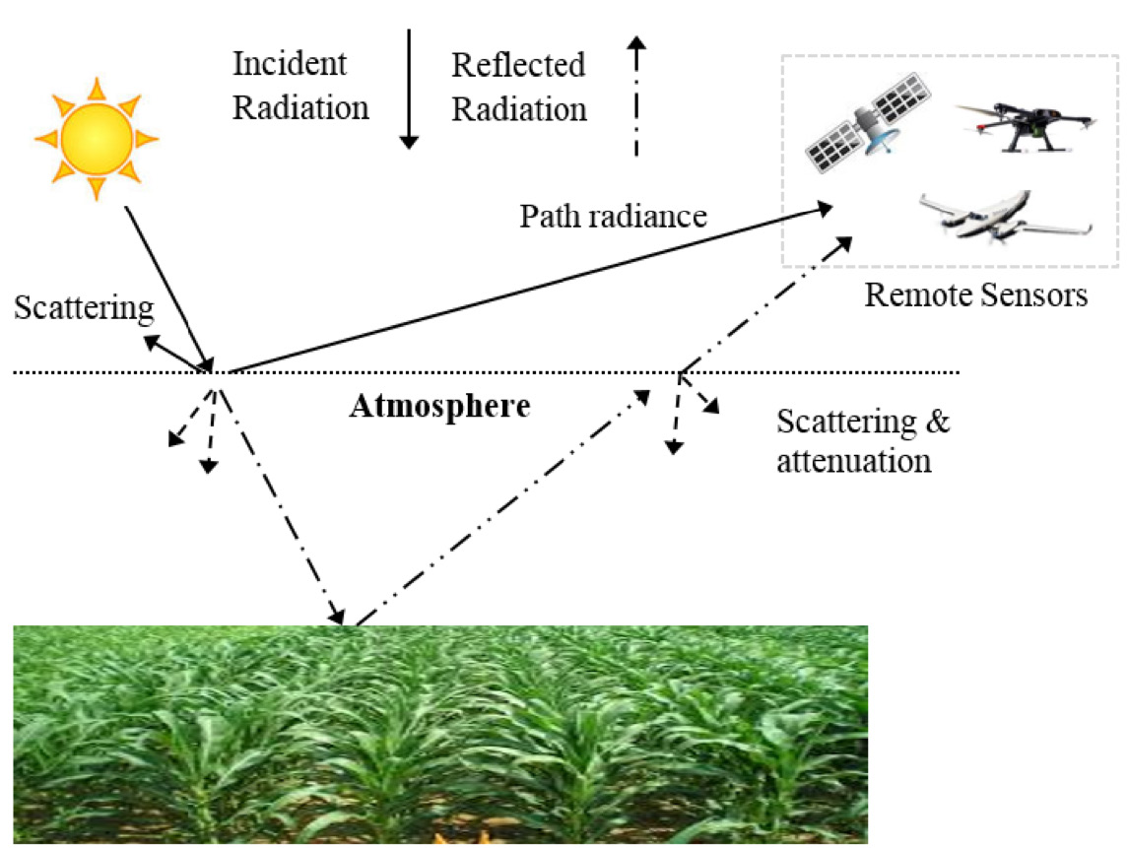
PRICISION FARMING AND REMOTE SENSING IN PRECISION AGRICULTURE

Slide 11
MILLET (RAGI)
Ragi: Irrigated preparation of main field.
1. Application of FYM or compost
spread 12.5t/ha of compost or composted coir pith evnly on the unploughed field and then plough and incorporate in the soil
2. Application of fertilizers
Soil test based fertilizer recommendation may be adopted in western and north western zones in soils of vertisls, alfisaols and inceptisols for prescribing the fertilizer dose for specified targets. If soil test is not available, adopt a banklet recommendantion of 60kg N, 30kg p2o5 and 30kg k2o per ha. Apply half the dose of N and full dose of p2o5 and k2o basally before planting.

Slide 12
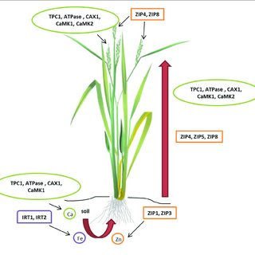
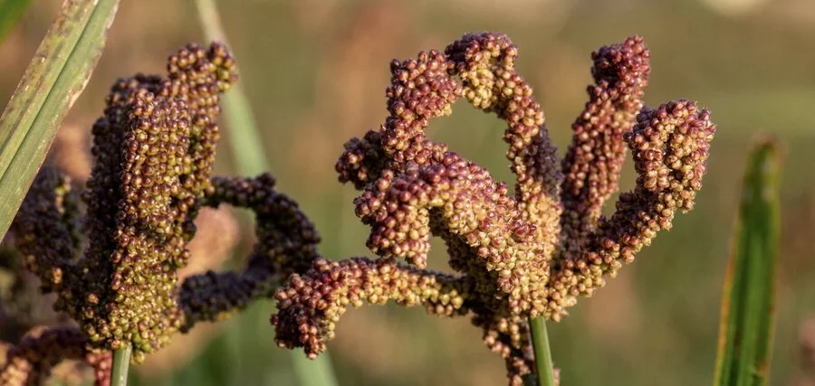
3. Application of micronutrient mixture
Mix 12.5 kg of micronutrient mixture formulated by the department of agriculture, apply the mixture evenly on the beds. Do not incorporate the mixture in the soil.
4. Management of main field
Root dipping with Azospirillum: Prepare slurry with 5 packets (1000g/ha) of Azospirillum and 5 packets (1000g/ha) of phosphobacteria or 10 packets of Azophos (2000g/ha) in 40 litres of water and dip the root portion of the seedling in the solution for 15-30 minutes and transplant.

Slide 13
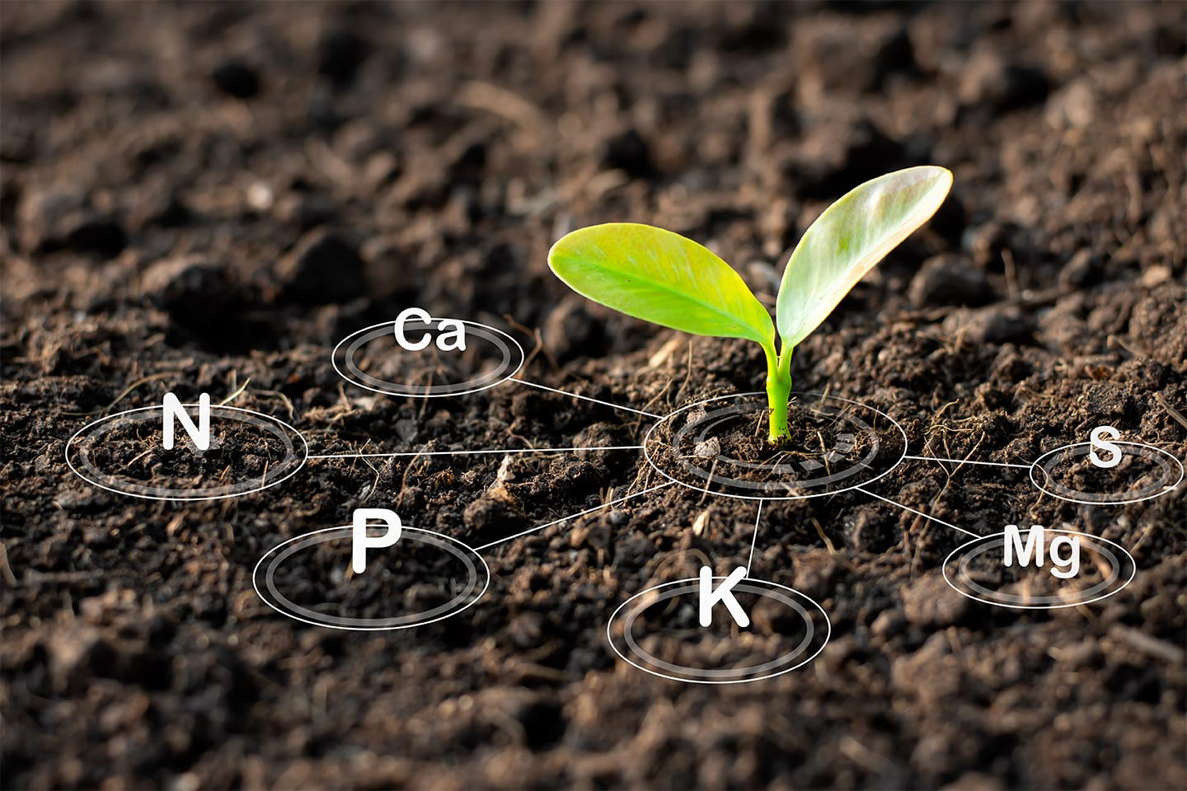

THANK YOU

